Slide 1
Introduction to Digital Electronics

Slide 2
Lecture 11 Logic Gates
Lecture delivered by:
Deepak V.

Slide 3
Objectives
At the end of this lecture, student will be able to:
Describe Binary Logic
Acquire the knowledge of Truth Tables
Acquire the knowledge of Logic Gates
Recognize Logic Gate Symbols and Behavior
Acquire the knowledge of Logic Diagrams and Expressions

Slide 4
Topics
Binary Logic
Truth Tables
Logic Function Implementation
Logic Gates
Logic Gate Symbols and Behavior
Logic Diagrams and Expressions

Slide 5
Binary Logic
Definition of Binary Logic
Binary logic consists of binary variables and a set of logical operations
The variables are designated by letters of the alphabet, such as A, B, C, x, y, z, etc, with each variable having two and only two distinct possible values: 1 and 0,
Three basic logical operations: AND, OR, and NOT
AND is denoted by a dot (·)
OR is denoted by a plus (+)
NOT is denoted by an overbar ( ¯ ), a single quote mark (') after, or (~) before the variable

Slide 6
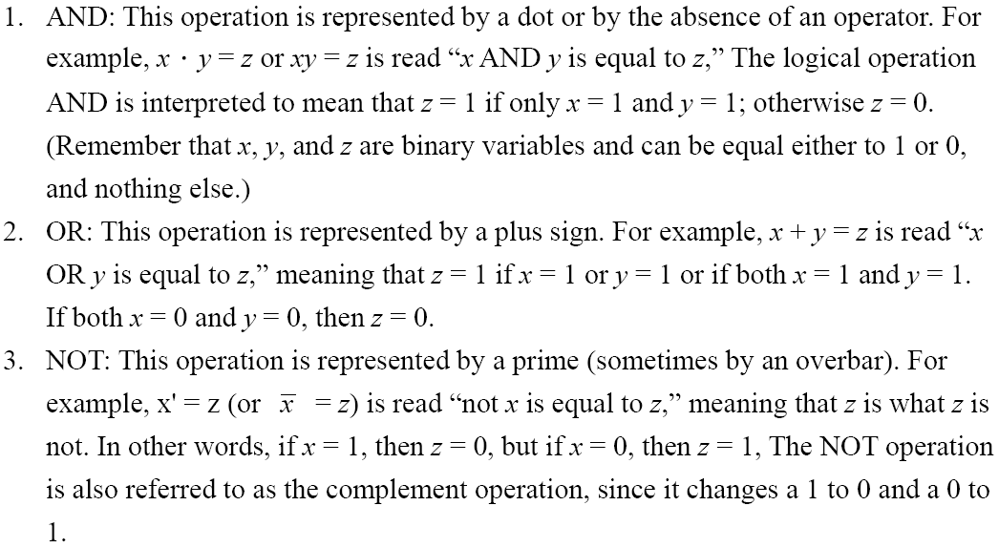
Binary Logic

Slide 7
Notation Examples
Examples:
Y = A . B is read “Y is equal to A AND B.”
Z = X + Y is read “z is equal to x OR y.”
X = Ā is read “X is equal to NOT A.”

Slide 8
Operator Definitions
Operations are defined on the values "0" and "1" for each operator:
AND
OR
NOT
0 · 0 = 0
0 + 0 = 0
0
=
1
0 · 1 = 0
0 + 1 = 1
1
=
0
1 · 0 = 0
1 + 0 = 1
1 · 1 = 1
1 + 1 = 1

Slide 9
Truth Tables
Truth table - A tabular listing of the values of a function for all possible combinations of values on its arguments
Example: Truth tables for the basic logic operations:
AND
OR
X | Y | Z = X+Y
0 | 0 | 0
0 | 1 | 1
1 | 0 | 1
1 | 1 | 1
NOT
X
Y
Z = X·Y
X
Z
=
X
0
0
0
0
1
0
1
0
1
0
1
0
0
1
1
1

Slide 10
Logic Function Implementation
Using Switches
For inputs:
logic 1 is switch closed
logic 0 is switch open
For outputs:
logic 1 is light on
logic 0 is light off
NOT uses a switch such that:
logic 1 is switch open
logic 0 is switch closed
Switches in parallel => OR
Switches in series => AND

Slide 11
Logic Gates
In the earliest computers, switches were opened and closed by magnetic fields produced by energizing coils in relays. The switches in turn opened and closed the current paths
Later, vacuum tubes that open and close current paths electronically replaced relays
Today, transistors are used as electronic switches that open and close current paths

Slide 12
Logic Gates
Implementation of logic gates with transistors
Transistor or tube implementations of logic functions are called logic gates or just gates
Transistor gate circuits can be modeled by switch circuits

Slide 13
Logic Gate Symbols and Behavior
Logic gates have special symbols:

Slide 14
Logic Diagrams and Expressions
Truth Table
Equation
X Y Z
F
=
X
+
Y
×
Z
0 0 0
0
F
=
X
+
Y
Z
0 0 1
1
0 1 0
0
Logic Diagram
0 1 1
0
X
1 0 0
1
1 0 1
1
Y
F
1 1 0
1
Z
1 1 1
1
Boolean equations, truth tables and logic diagrams describe the same function
Truth tables are unique; expressions and logic diagrams are not. This gives flexibility in implementing functions

Slide 15
Summary
Binary logic consists of binary variables and a set of logical operations
Three basic logical operations are: AND, OR, and NOT
A tabular listing of the values of a function for all possible combinations of values on its arguments is called truth table
Boolean equations, truth tables and logic diagrams describe the same function

